Slide 1
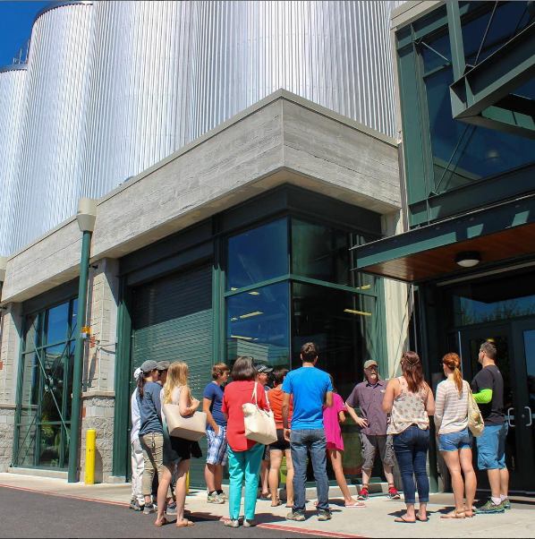
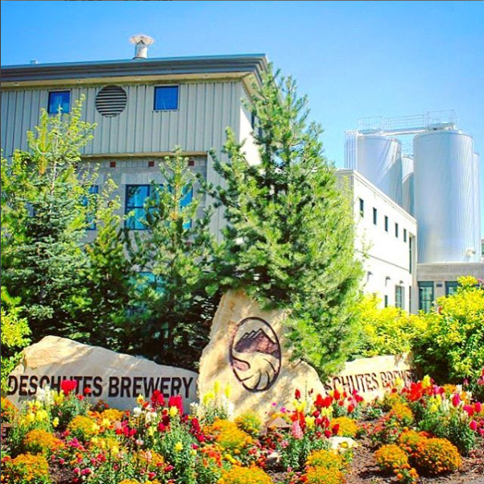
Hops: The Why & The Experimental

Slide 2
How’d We Get Here
Quick nod to Ted Hausotter on “Getting the most from your Hops!”
Look for Jeff Barnes’ “From Field to Brew: Hop Growing and Experimental Brewing”, Saturday @ 2:45 PM.
Recent article in Zymurgy talking about the prehistoric travel of hops.
Beer historians cite ‘gruit’ as the original bittering component in beer (technically ale if hops weren’t used) and there are multiple theories as to why hops eventually replaced it. In the end, who really wants a bunch of flowers and herbs in their beer?
Jump ahead many centuries to now, and we are fortunate enough to have around 146 varieties of hops at our disposal with dozens being researched each year.

Slide 3
Hop Plant Review
The hop plant is a perennial, the rhizome (base), while the growth is not.
Male and female plants are usually grown separately to avoid pollination; female produces cones (not flowers), male produces cones and seeds. Resins and essential oils are what we as brewers are after and it all hides in the lupulin glands.
Resins = Alpha acids which have to be isomerized by the boil and Beta acids which can contribute a small amount of bitterness when oxidized. α acids act as a preservative due to antibacterial properties and help protect against gram positive bacteria (lactobacillus and pediococcus mostly).
Essential Oils = aroma which is very volatile and flavor (recent research claims that this may not be true).
Plants grown from seeds vary (from crop year to crop year and from hill to hill) to a large enough extent that almost all commercial hops are grown from vegetative propagation (root cutting from established plant or softwood cutting from newly grown steam and leaf). This insures varietal purity.
Generally broken into three different types: bittering (high in α acids, and/or humulone, and/or adhumulone, and/or cohumulone), aroma (high in oils such as humulene, caryophyllene, farnesene, and myrcene), dual-purpose.

Slide 4
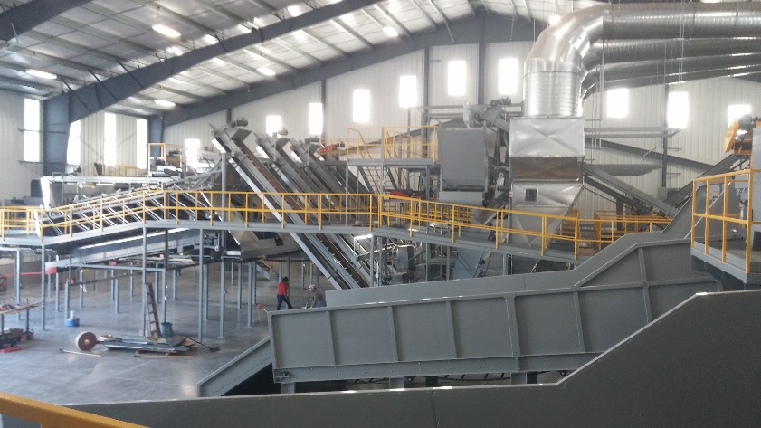
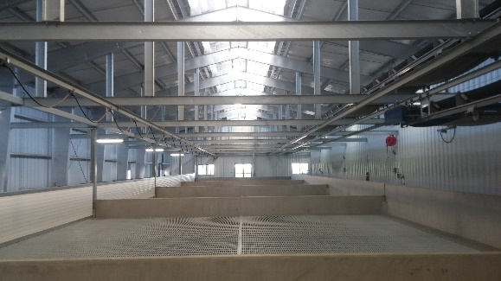
Hops at Deschutes
Whole cones and why.
Hop strainer.
Dry hopping vs. hop strainer (reference recent Hopsteiner research on dry hopping impact to IBU).
IBU = mg. isomerized α acids/liter.
Hop selection: best hops vs. year-to-year consistency.
Pg. 91 of MBAA Raw Mats book for a good review of desirable and undesirable qualities.
Some aromas volatize off during fermentation; garlic and onion being notable ones (Mosaic hops anyone?). Those same aromas fade from the hop bales as they age.
Evaluating physical condition of hops as well and is a topic being talked about even now.
Review our process of rotating hops to address changes during the crop year and from year-to-year.
Fresh hop beers and the dosing rates used to adjust for such.
Hop products and the reasons Deschutes uses them.
Whole Cone Hops, T-90 and T-45 Pellets, T-35 (hammer milled), C02 Extract.
Hop products outside of the scope of Deschutes Brewery.
Light-stable extracts (Rho, Tetra, and Hexa are used to avoid 3-methyl-2-butene-1-thiol (MBT, detectable at 10 parts per trillion)).
How and why we use experimental hops…

Slide 5
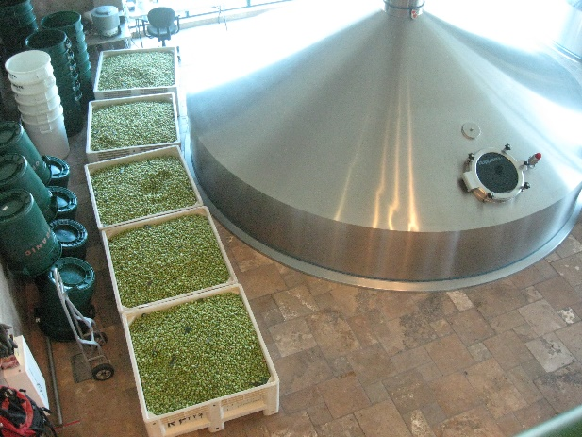
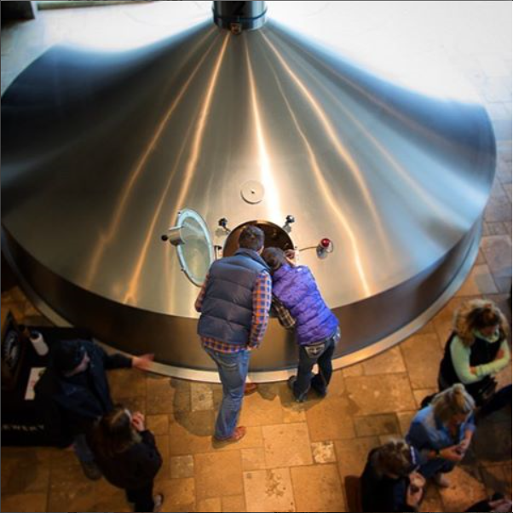
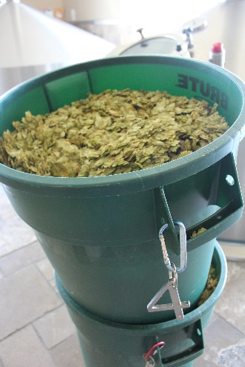
Hops at Deschutes
Fresh hop beers and the dosing rates used to adjust for such.
‘Chasin’ Freshies’ is a real world example of the garlic and onion volatizing off the year we used fresh Mosaic hops.
Hop products and the reasons Deschutes uses them.
Whole Cone Hops, T-90 and T-45 Pellets, T-35 (hammer milled), C02 Extract.
Hop products outside of the scope of Deschutes Brewery.
Light-stable extracts (Rho, Tetra, and Hexa are used to avoid 3-methyl-2-butene-1-thiol (MBT, detectable at 10 parts per trillion)).
Lab sensory panel: tasting every tank before releasing to bottling or kegging, constantly monitoring IBU throughout the process stream, GCMS used to track aromatic compounds and create brand profiles that allow us to vet process changes.
How and why we use experimental hops…

Slide 6
Quick Breeding Overview
Most handled through Hop Research Council. Other notable contributors are Oregon State University and Washington State University.
Create new hops with high alpha for bittering and/or unique aroma.
Create new hops that are disease and pest resistant (powdery mildew, downy mildew, etc.).
Create higher yielding strains of existing varieties.

Slide 7
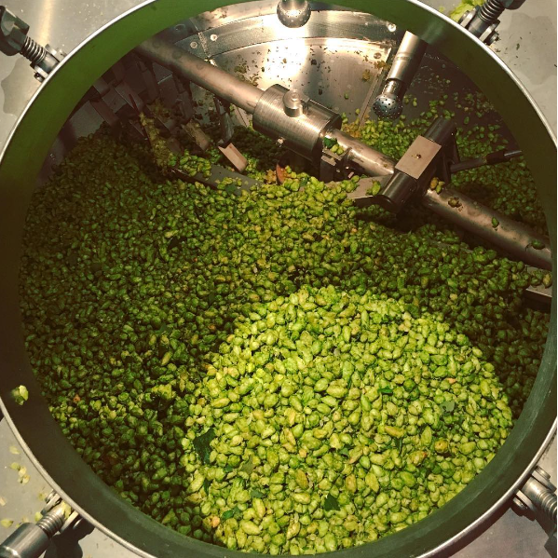
Advice and Tips
Best way to store hops (air, heat, light, and humidity).
Oxidation leads to aromas of cheese (isovaleric).
In the US, typically stored around 26°F.
HSI and why it matters.
Different ways to use hops for different impact on beer.
Aroma & flavor via hopback, describe OSU results in pilot plant. Dry hopping…
The vast majority of utilization happens in the first 60 minutes and falls to the law of diminishing returns rapidly after that.
High pH increases utilization rates as does lower gravity.
Heavy dosing rates impact utilization.
Yeast strain impacts utilization.
In general, hops improve foam (stability in particular).
Using hop teas or light beer dry hopping to test hop varieties at home.

Slide 8
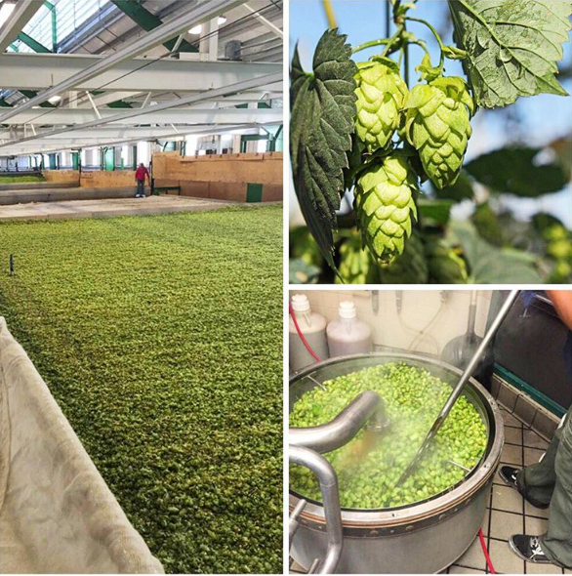
That’s Interesting
Craft beer is predicted to grow 20% through 2020 and hop growers are indicating we may have a worldwide hop shortage next year.
Yakima grows roughly 80% of the hops grown in the US.

